Slide 1

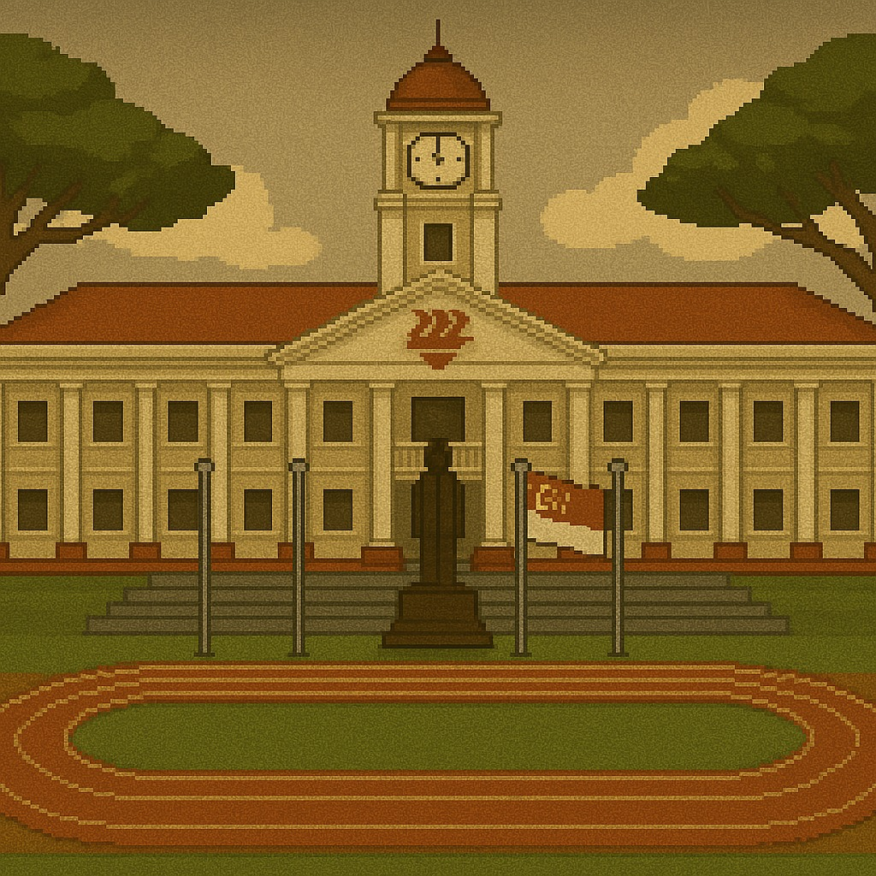
Start

Slide 2
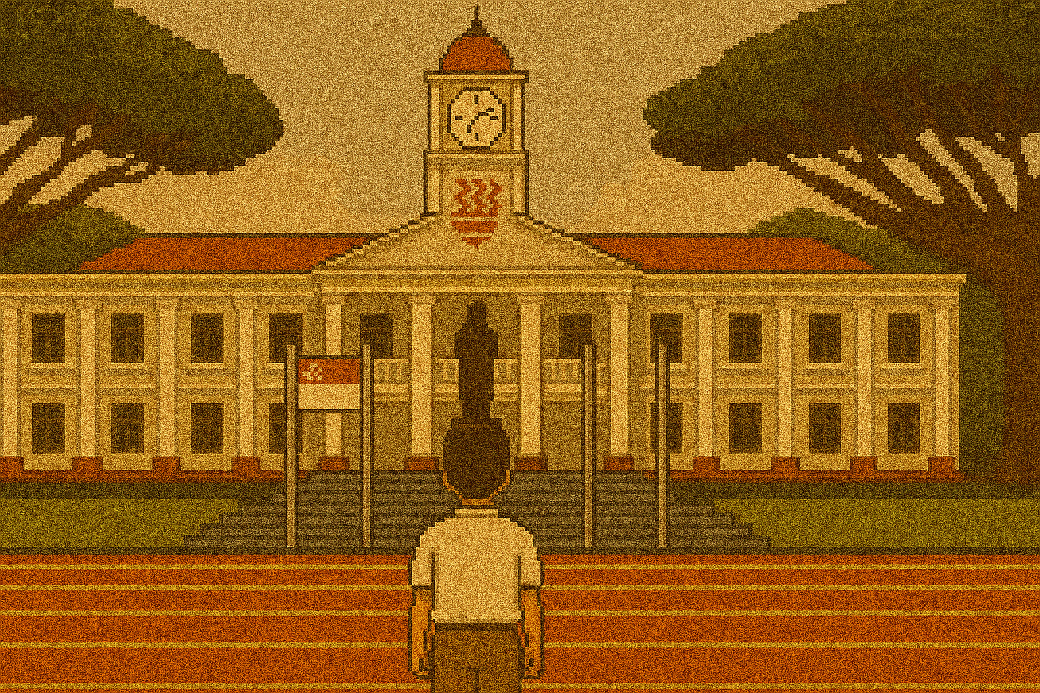

Start
Woah.. I can't believe I actually made it here..

Slide 3
Start
My dream school, Hwa Chong Institution!

Slide 4
Start
(Are you ready to embark on this adventure?)
YES!

Slide 5
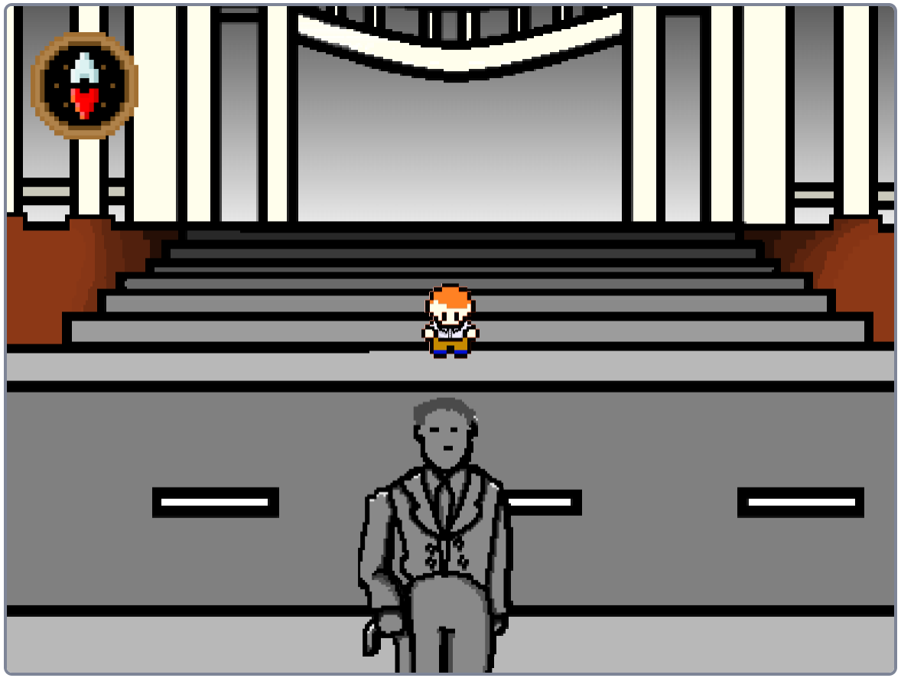
OK!

Slide 6
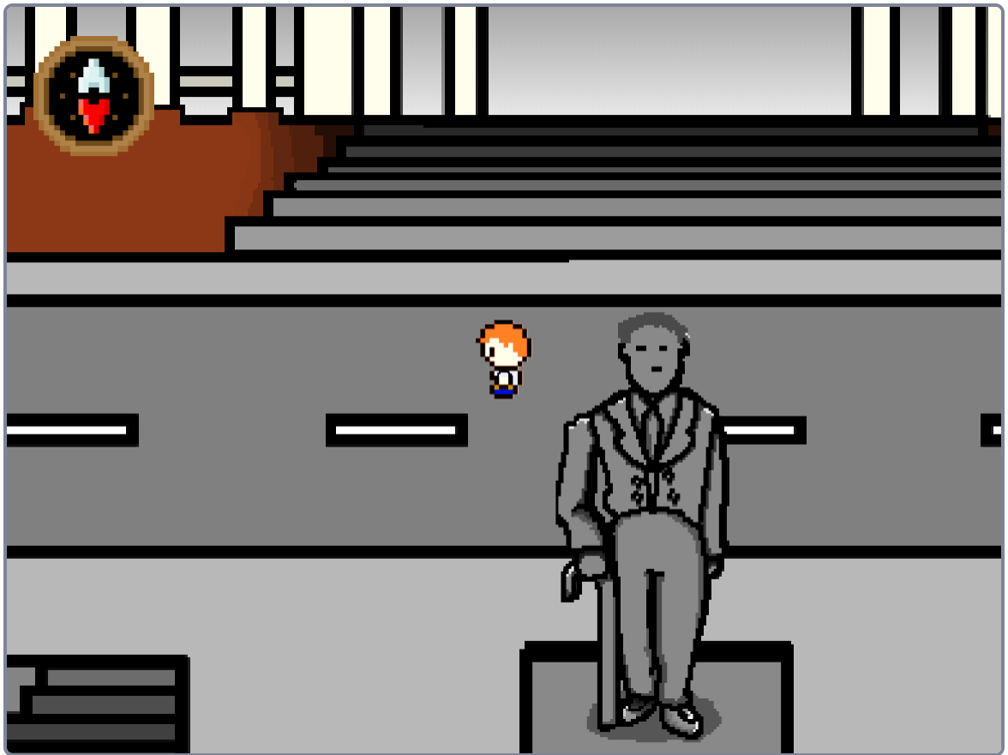
OK!

Slide 7
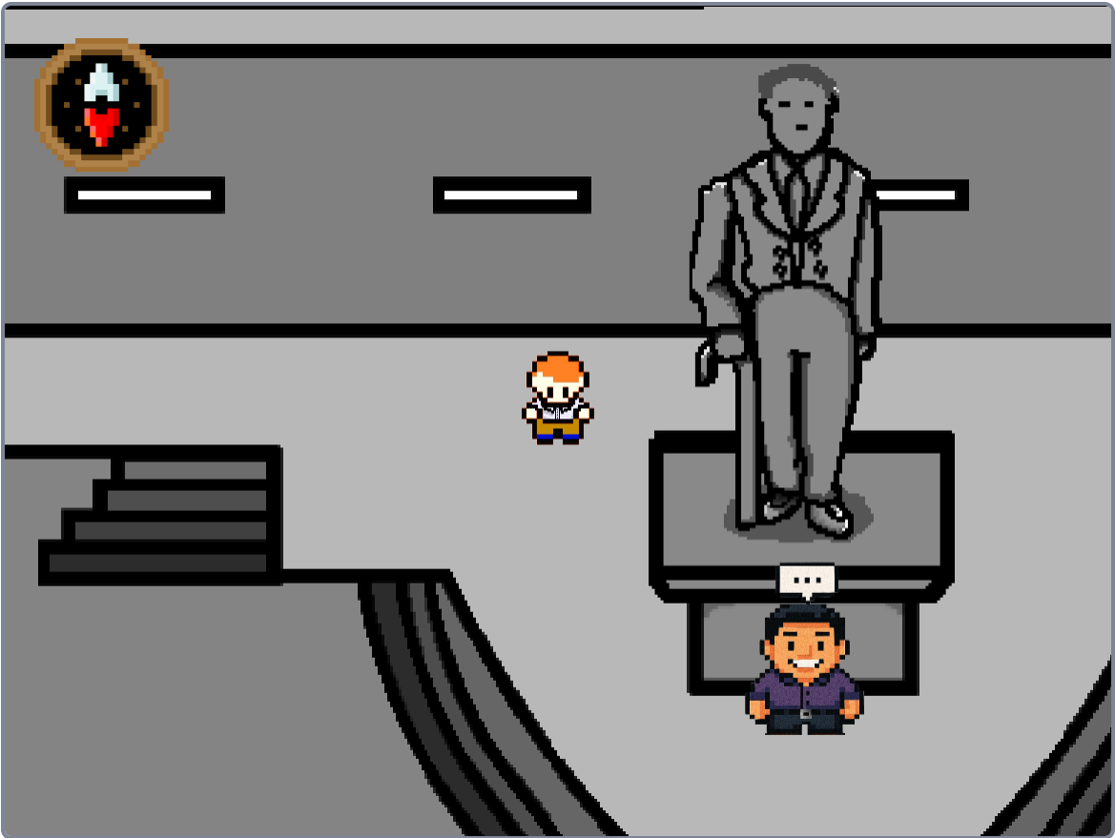

Slide 8
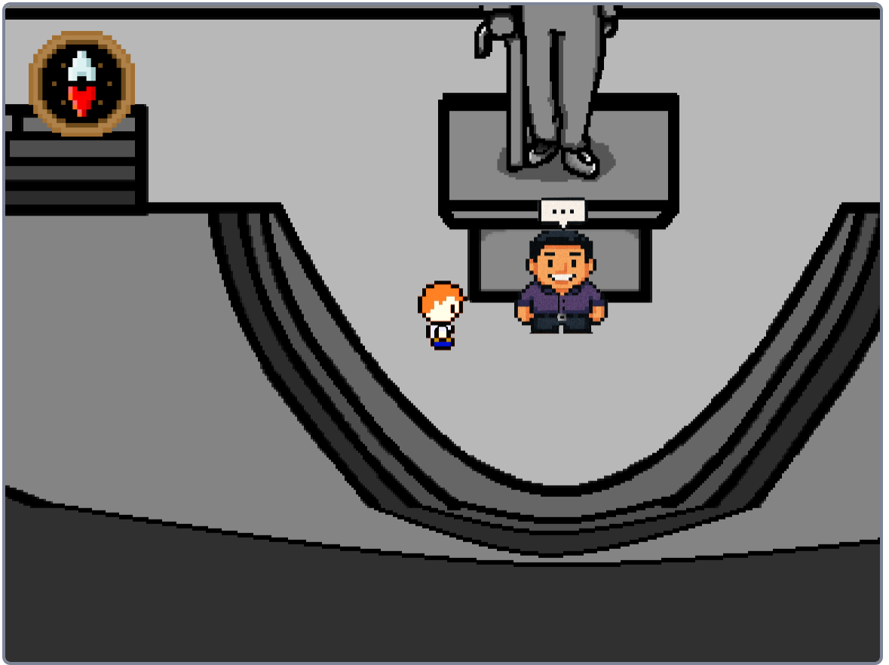

Slide 9

OK!
Hello dear student!

Slide 10
OK!
I am Mr Lee , the current principal of Hwa Chong Institution!

Slide 11
OK!
HCI is in a critical state right now..!

Slide 12
OK!
Our historical artifacts are all gone!!!!

Slide 13
OK!
We're not sure where or how they disappeared, but we're most definitely sure you can help us!

Slide 14
OK!
We need you to retrieve the artifacts in the form of time capsules!

Slide 15
OK!
To do that, you might have to meet the different alumni and founders of HCI, they might know the location!

Slide 16
OK!
Here's a GPS, it should help you out with searching a ton!

Slide 17
OK!
Oh, and remember, you can always check the bulletin board if you ever get lost!

Slide 18
OK!
Goodluck, and do your best!

Slide 20
Yes
O

Slide 21
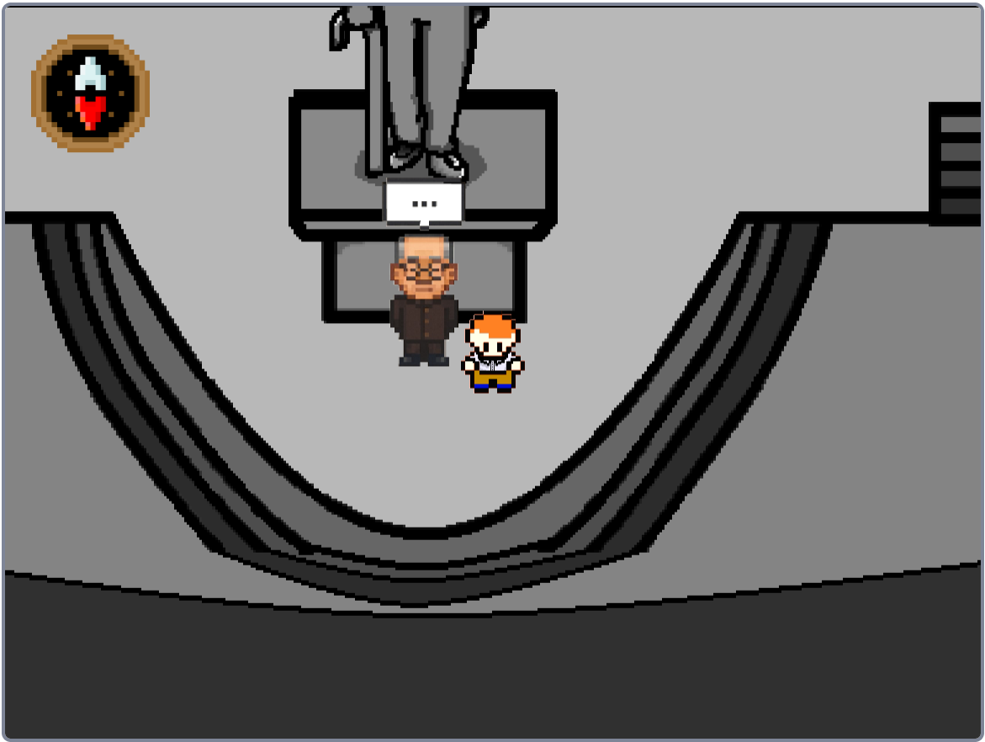
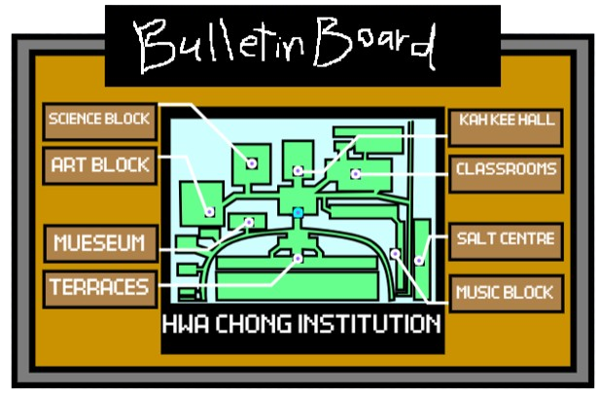

X
X
Go

Slide 23

OK!
Hello, I Am Dr Lee Kong Chian

Slide 24
OK!
I see that you're trying to retrieve a time capsule, but it won't be so easy.

Slide 25
OK!
Do you even know the history behind one of Singapore's greatest..

Slide 26
OK!
most amazing..

Slide 27
OK!
philanthropists of all time?!
Uhh...

Slide 28
OK!
Go out there and research, maybe you'll learn a thing or two...
Alright!

Slide 29
OK!

Slide 30
OK!
Do 3 side quests, such as
Finding a certain book in the library
Asking A HSC student
Finding more at the Kuo Chuan House

Slide 31
OK!

Slide 32
OK!
Hmm.. You're back, huh?

Slide 33
OK!
POP QUIZ!!

Slide 34
OK!
POP QUIZ!!

Slide 35
OK!
Who is a Chinese Philanthropist who helped Hwa Chong Institution
Dr Lee Kong Chian
Mr Lee Kuan Yew

Slide 36
OK!
Congrats ! You got it correct! Its me I helped out Hwa Chong along with my father in law!
This is a Capsule your first of many
Cool!

Slide 37
OK!
Would you like to deposit this in the clock tower
Deposit

Slide 38

OK!
You Got it wrong :C It was me.
Go to the canteen and buy an ice milo for me and maybe I’ll consider giving you another chance hehe:d
Go to canteen

Slide 40
OK!
Your back so fast?
Ok fine ! Ill give you another chance. Here is the time capsule
OK!

Slide 41




OK!
O

Slide 42
OK!
O
Time capsules retrieved: 0/10
GPS
Money: $10 (to buy iced milo)
Time capsule locations

Slide 43
THANK YOU!

